Slide 1



SUBMARINE WAR
C Program

Slide 2
CONTENTS
Problem Statement
Analysis
Design
Implementation
Testing

Slide 3
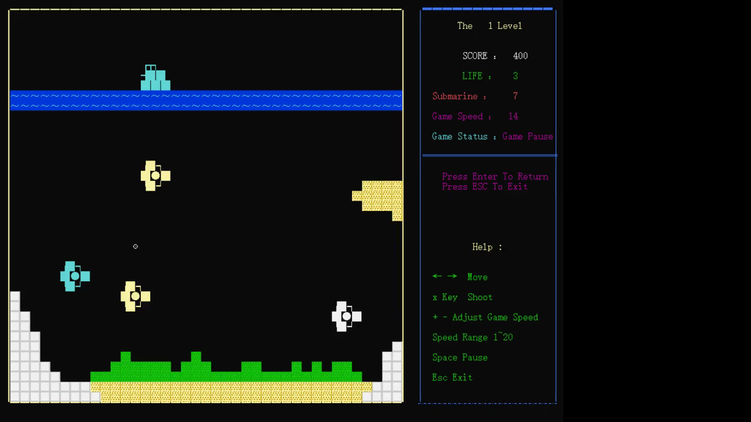
Problem Statement
Our program is a game called “Submarine war”. There are eight levels in the game, each of which is different in difficulty. The user can adjust the speed of game according to their need.
△Four types of AI-Submarines can appear randomly and move freely and fire bullets at random.
△The game interface can display the current game speed, score, the number of remaining enemies and so on;
△Prevent data transboundary

Slide 4
Analysis
Conditional constraints:
1: Every moving object in the game moves in a specific range to prevent data from corossing the boundary.;
2:Function classification, the program can be divided into three categories. A class of game auxiliary functions. A bullet system, a ship/AI-ship system.
Requirement:
1. Keyboard message (coordinates , X key and direction keys and so on)
2. 3 Functions:
A function to move AI-Submarines;
A function to fire bullets;
A function to real-time display of current game status.

Slide 5
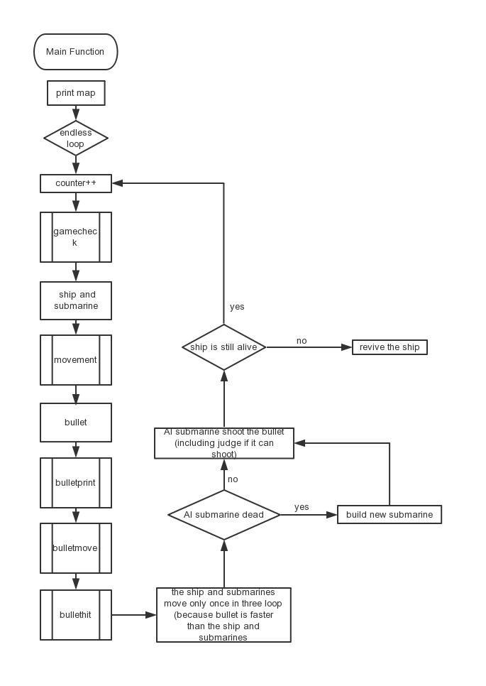
Design

Slide 6
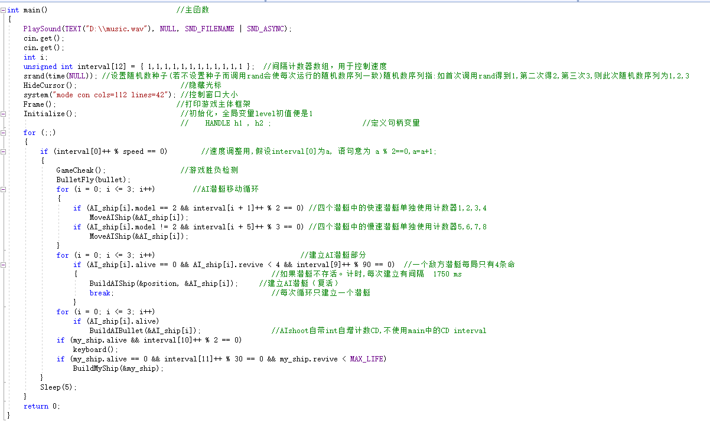
Implementation
1: Counter + Cyclic Judgment: Implementing Dead Loop Body of Program Main Function

Slide 7
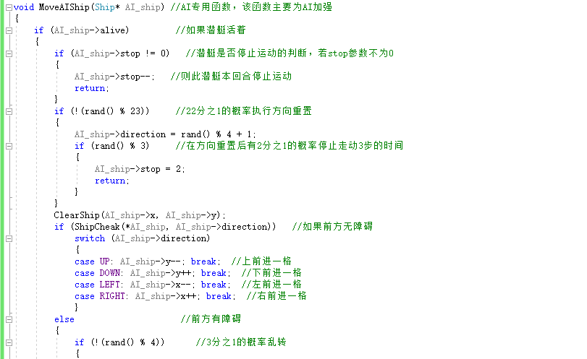
2: Rand funtion: realize the intelligent submarine and increase the fun of the game

Slide 8
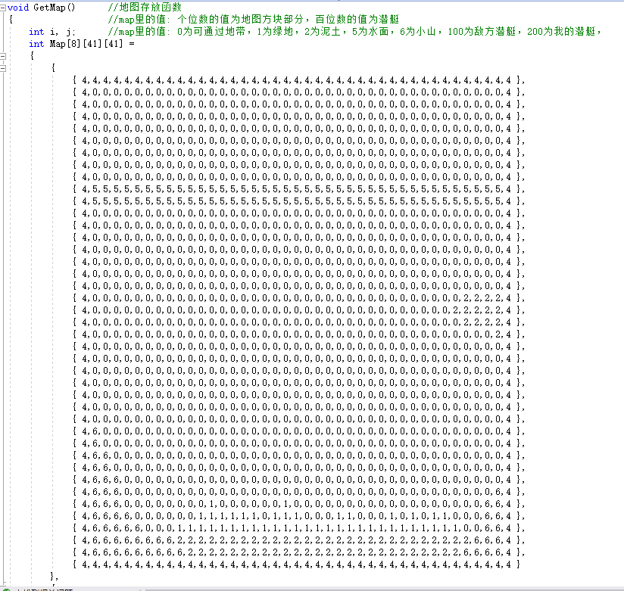
3:Inner and outer table: realizing the motion of objects and the visualization of of Game Operating Interface

Slide 9
Test
Input | Expected result | Real result
“←” “→” | My ship moves to the left and the right respectively | My ship moves to the left and the right respectively
X Key | My ship fires bullets down | My ship fire bullets down
Enter Key | AI-Submarine randomly appear and move , periodically launch bullets | AI-Submarine randomly appear and move , periodically launch bullets
 | Display current score, remaining enemies, and remaining lifes, game speed. | Display current score, remaining enemies, and remaining lifes, game speed.

Slide 10
conclusion
1:Good game balance
refers to the game Subhunter on FC/Family Computer in the 1980s, including maps, game modes and so on (the game was burned directly on the circuit board at that time).
2: Strong adaptability
adjust to the appropriate speed according to PC performance.

Slide 11
Thanks for listening

